Slide 1
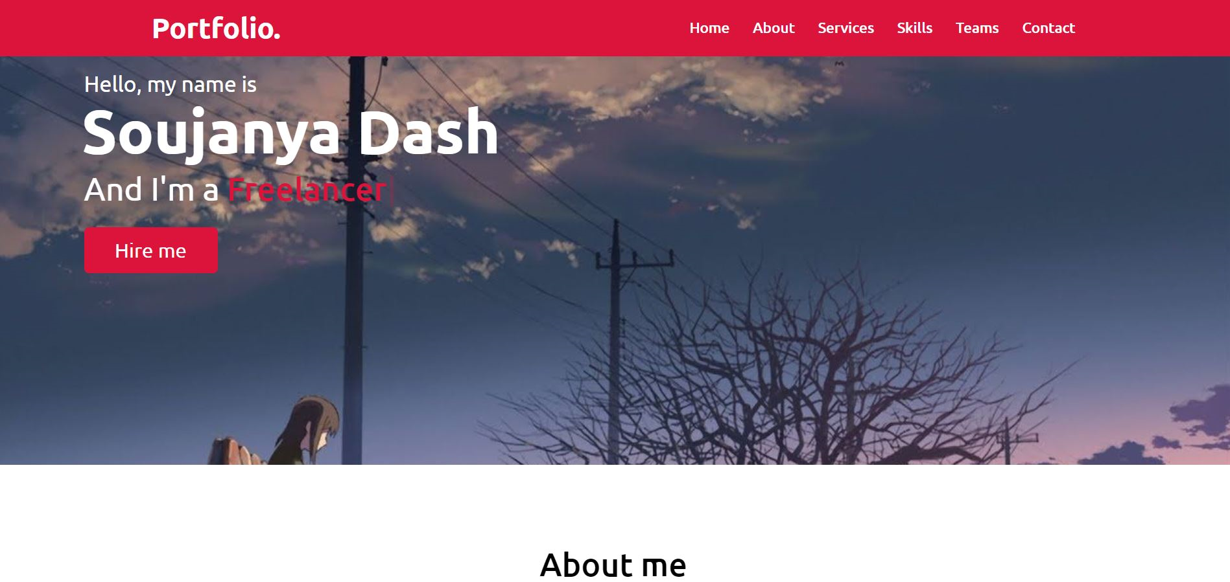
Project on Portfolio website “RirekiSHOW!!”
Name: DASH Soujanya
ID: 12418113
Email: soujda18@apu.ac.jp
Lecturer: Professor Nishantha Giguruwa

Slide 2

Project Type: A
RirekiSHOW!!
Description of the project:
A responsive portfolio website to make an impact during job-hunting as “First impression is the last impression”. The use of various webservices are to be deployed, each of which have different implementations.
Purpose of the project:
To make a responsive design such that I can put together my website which automatically distinguishes its contents and elements to match the screen size on which it can be viewed.
Focuses on the job-hunting scenario and an interactive platform for both companies and candidates. There will be two domains, one for the company to log into and the other one for the candidate.
Connecting employers to potential employee without any hassle (without any language barrier). A third party intermediary between companies and potential employee.
Tentative Logo of the RirekiSHOW!! Website
Portfolio/ resume is generally associated with writing which is signified by the pencil here. This is in turn enclosed within HTML tags (closing tags) which show that the resumes are encrypted in one page which contains all the information. (SPA)

Slide 3

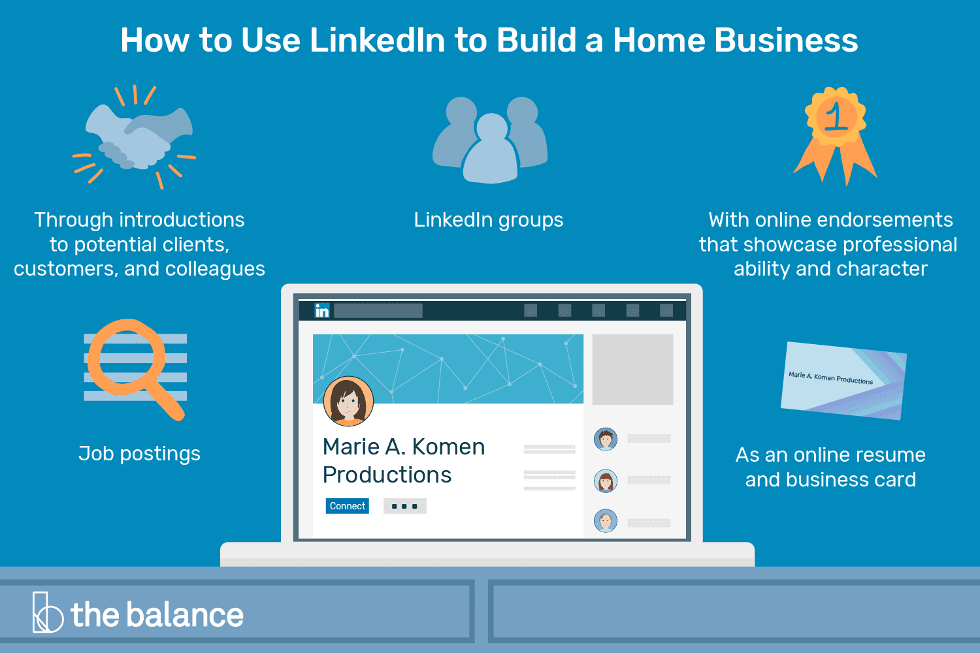
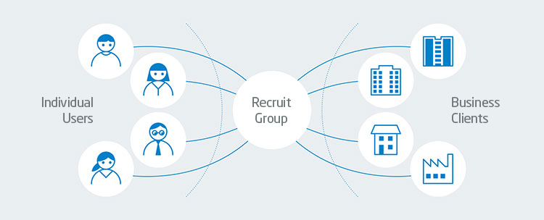
Functioning of LinkedIn
Purpose of LinkedIn: Formal social media where user creates profiles highlighting current and prior work experience. One can connect with colleagues and build network that can help advance in your career. Online directory of individual professionals that facilitates the networking without having to leave office.
Functioning of Recruit Japan
Functioning:
Key feature of profile is the ability to be recommended by current and previous employers and to be endorsed for a particular skill set. LinkedIn uses an algorithm that’s updated. The feed goes into rating filters that are to search for spam. Once content has arrived, one can engage with the content via a comment, a "like" or a share. In addition to LinkedIn's computer filters, actual humans also weigh in on the content. They might allow the content to continue to appear in users' feeds. Once one has built your LinkedIn profile, you can use the site to build your professional image.
Purpose: they are focused on creating new value for our society to contribute to a brighter world where all individuals can live life to the fullest. They have connected individuals and businesses offering both a multitude of choices.
Recruit Group has sought to act as a meeting place that brings together individual users and business clients, with a focus on services in the field of life-events and lifestyle, ranging from education to employment, and beauty to dining out. By providing a common platform through which users can find the service that best meets their needs, and business owners can connect with their ideal customers, we can facilitate the best possible matches for the mutual benefit of both parties. We refer to this two-sided marketplace business model as the 'ribbon model,' with the two sides connected with the tying of a ribbon.

Slide 4
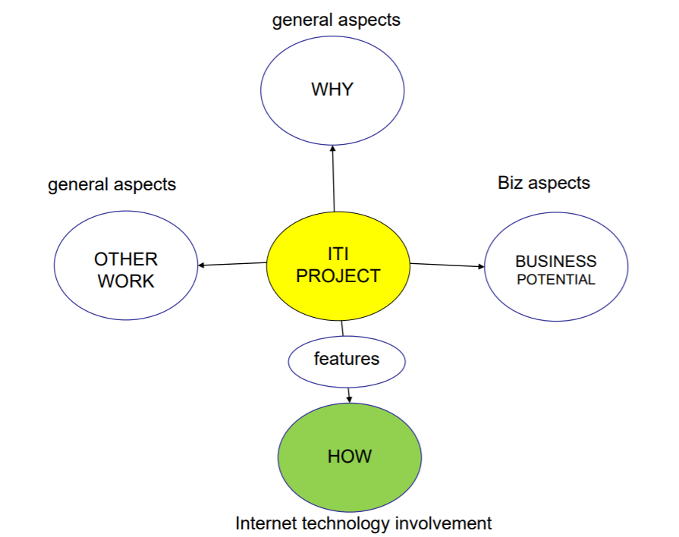
Features
Responsive Design (to adapt to mobile, tablet, desktop sizes)- user friendly view.
user login through social media integration, through normal sign-up registration process
Verification less authentication of registration data, captcha
Dashboard- personalized user less client dashboard (filter)
Creation of job profile- user less client
Provisions to use third-party API for JSON/ XML feets
Interactive and user-friendly interface
Online payment solution
Google translation
Platform for job seekers and providers to get connected to each other
Privacy (disclaimer)
Navigation menu and search box
User less client newsletter subscription
Job notification system (new job postings)
Loginizer to block suspicious log-in attempts: log-in protection to restrict login attempts in terms of security
DDoS attack protection to restrict site security breach from scammer/ hackers

Slide 5
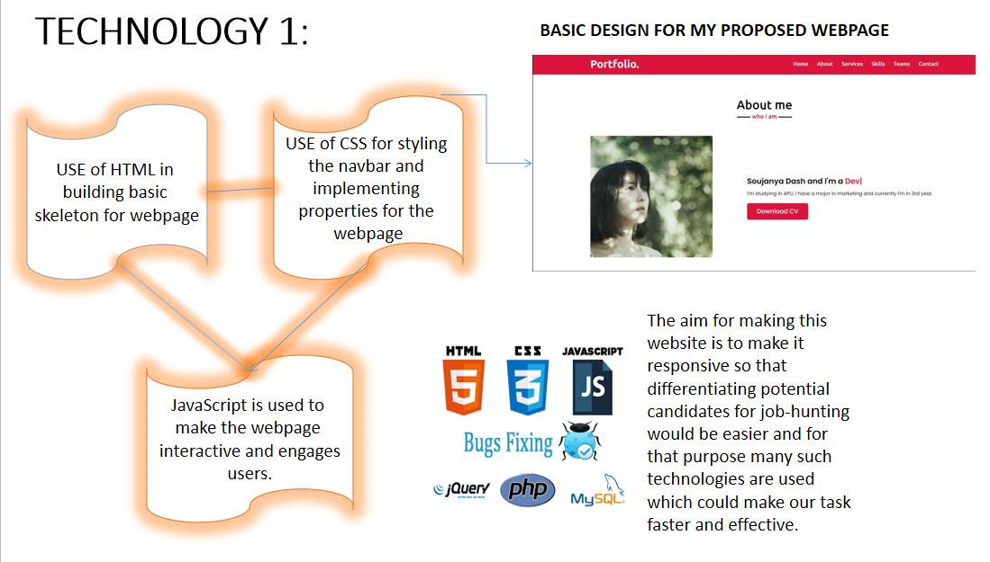
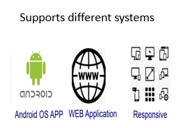
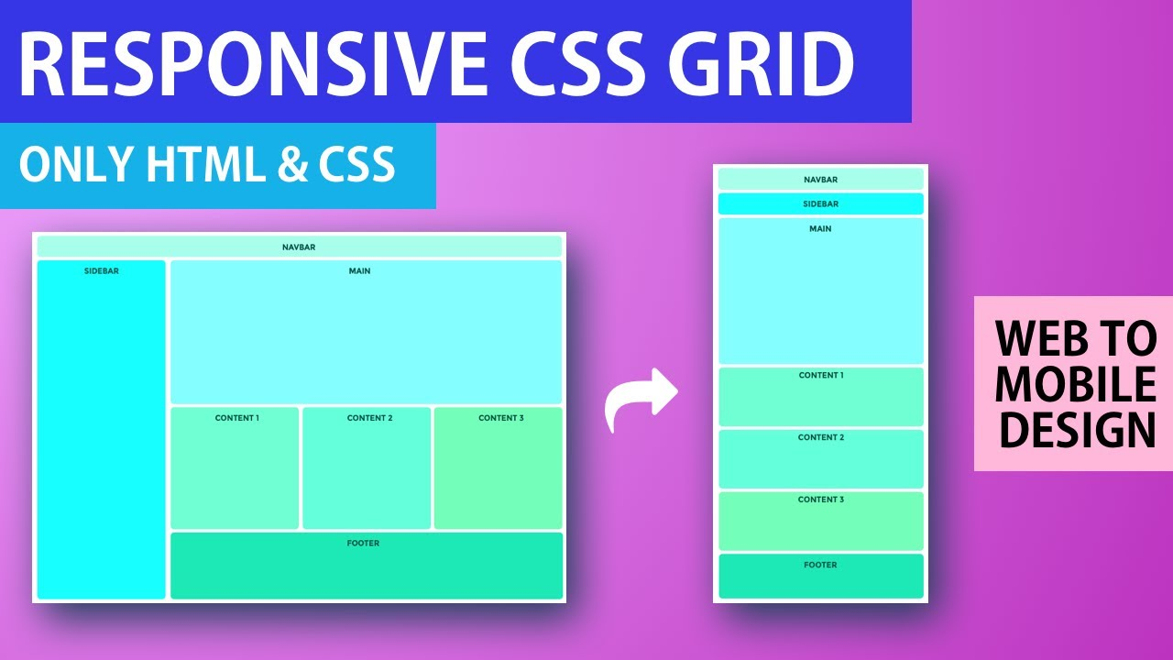

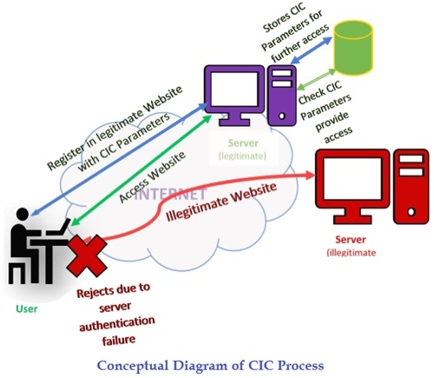
Social media integration
Verification less authentication of registration data, captcha

Slide 6

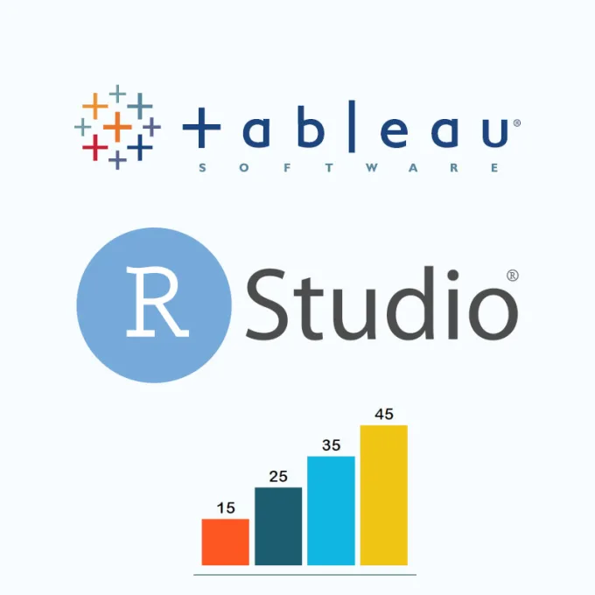
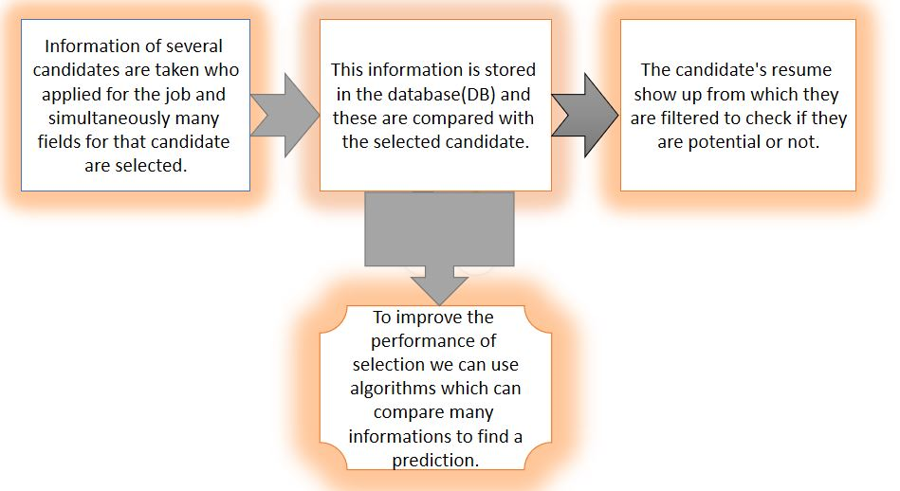
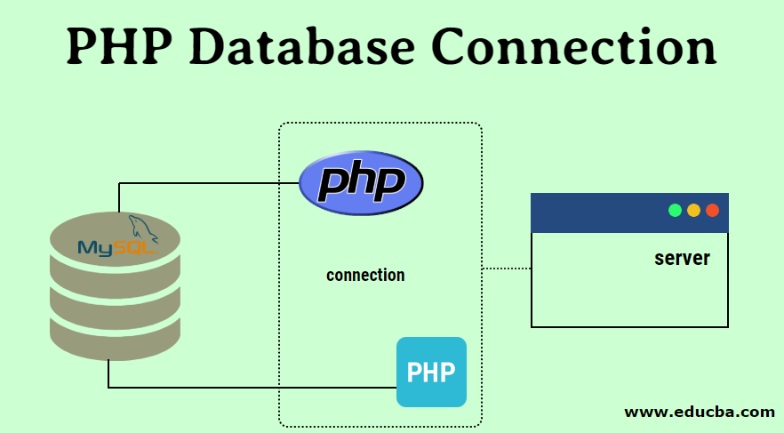


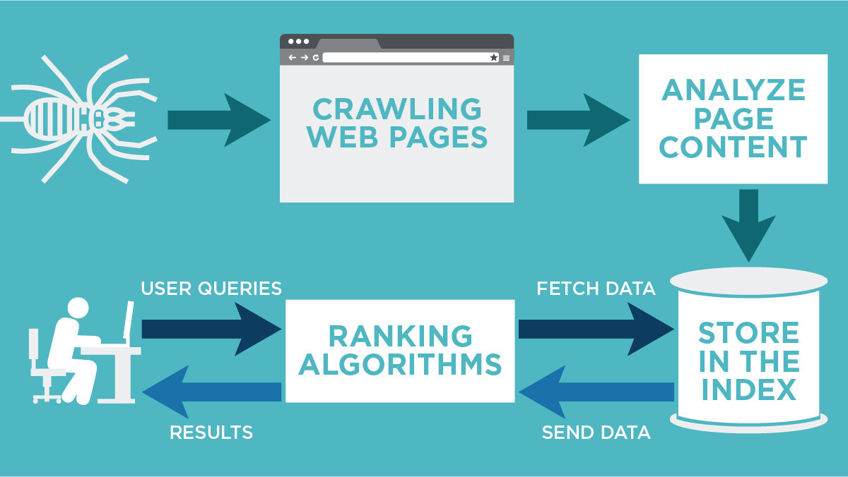
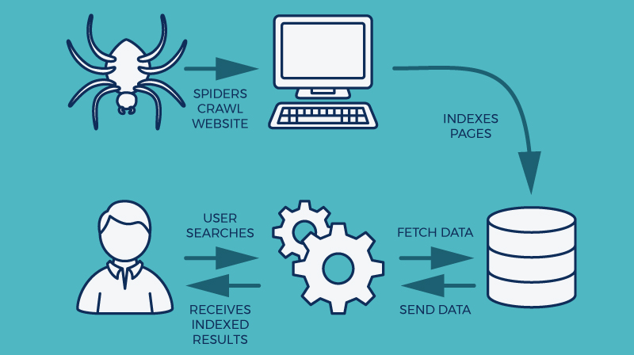
Technical aspect ( How to get the source of the data?)
User info.
Company and user click records using cookies
Data
Search Engine Optimization & User query indexing
(Training & Testing)
External sources using web crawling
Better suggestions for connections to company and employee.
Better User Experience (UX)

Slide 7
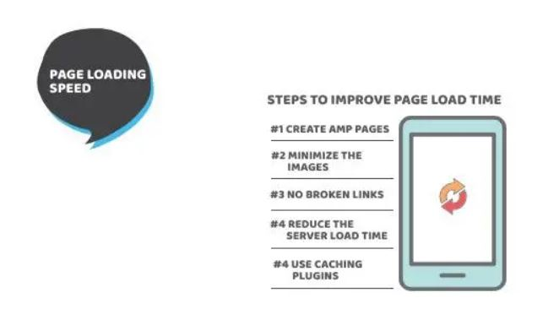
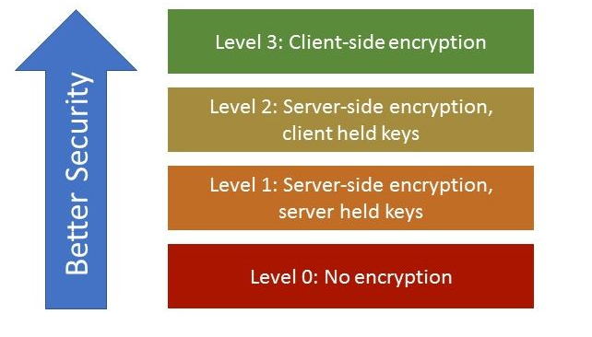
IoT implementation
Random OTP generation using IoT.
Password recognition for various clients who have used this webpage earlier which uses a dropdown box asking for either saving or cancelling the password.
Graphical User Interface(GUI) includes the front end interface and back end interface which can communicate with many smart devices from both sides user and server end.
Enhancing user friendly medium
Notes:
Enhancing user friendly medium

Slide 8
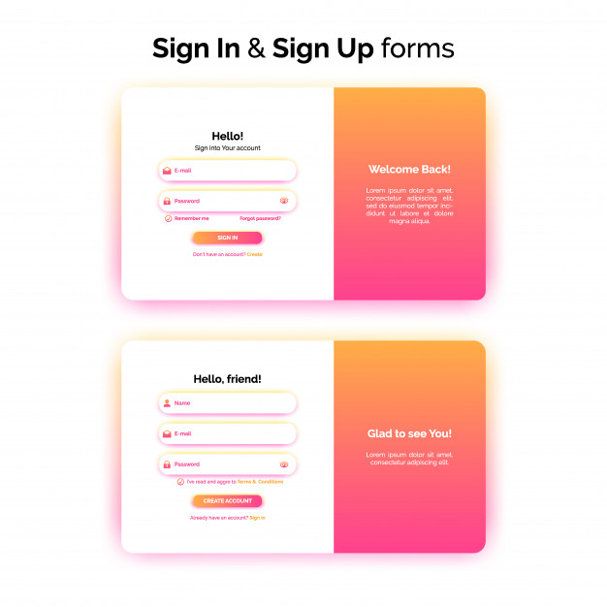
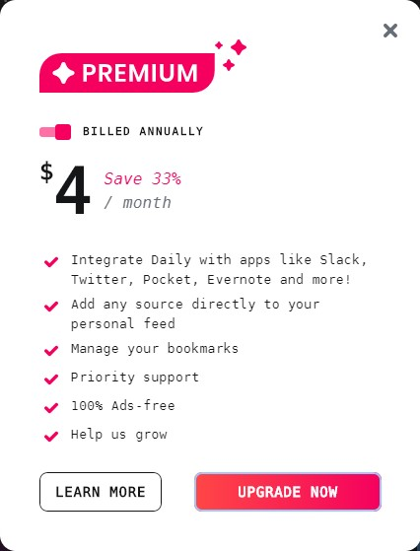


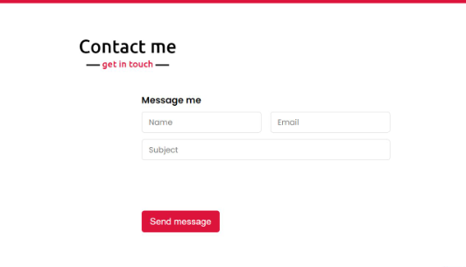
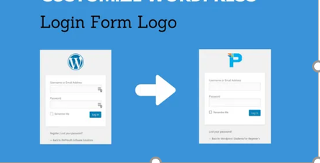

Customer Point of view
Direct Stakeholders: University students, fresh graduates, people with qualifications and job experience who want to change their job.
Companies, Recruitment agencies
Indirect stakeholders: Universities, GOOGLE AdSense users, parents, teachers
Revenue generation using AdSense
Free sites
Free
Notes:
Two ways of log in for users (Pricing strategy). Free account will have ad using Google Adsense for revenue generation (for the site).

Slide 9
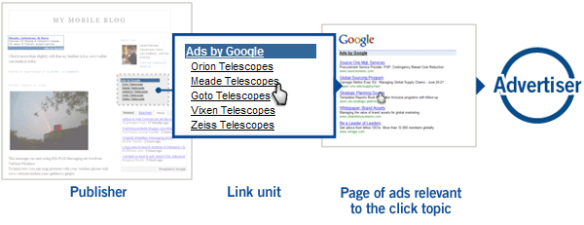
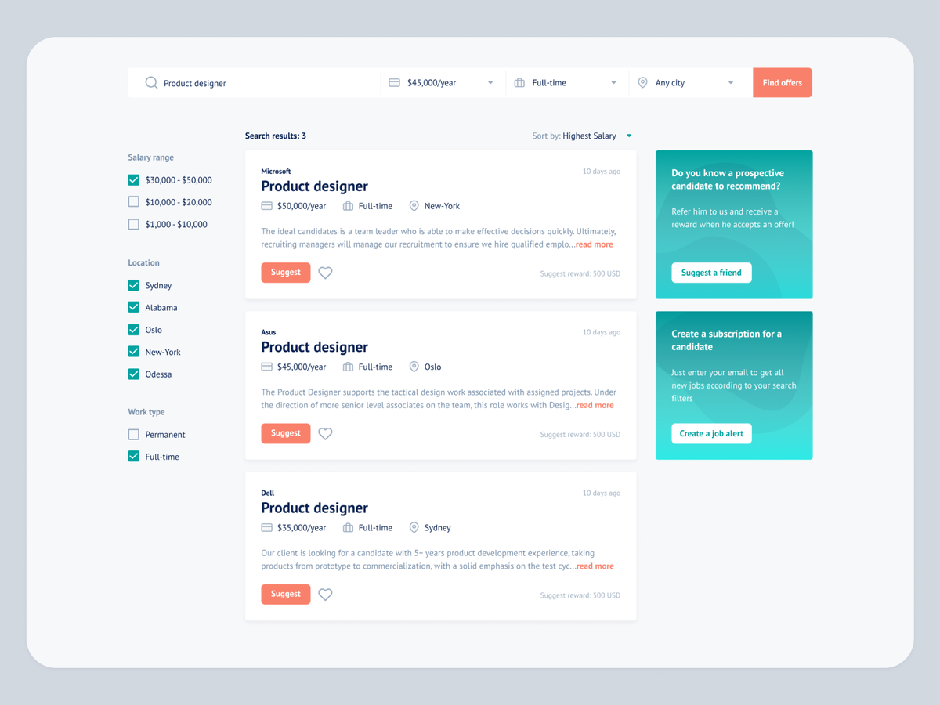
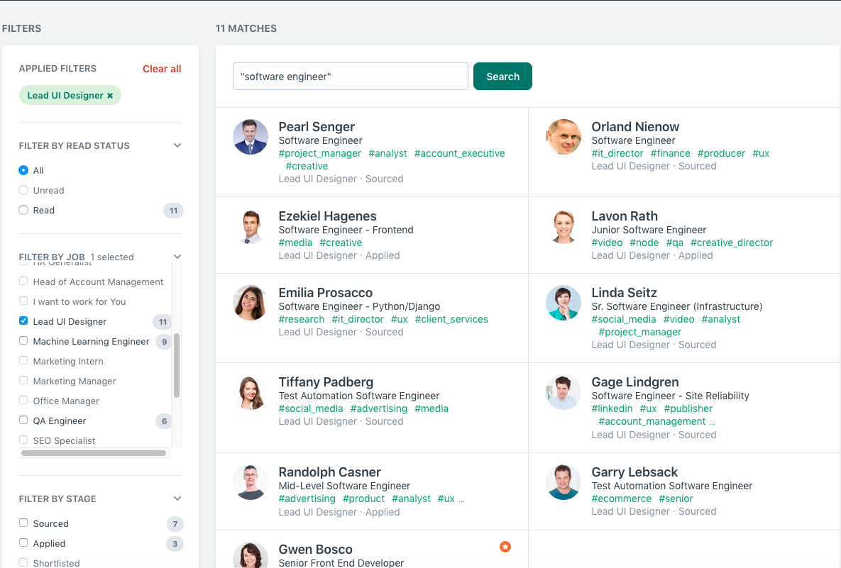
Filters can be used to find the ‘right’ candidate

Slide 10
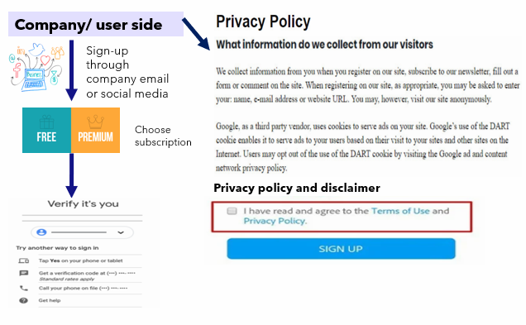
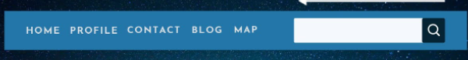
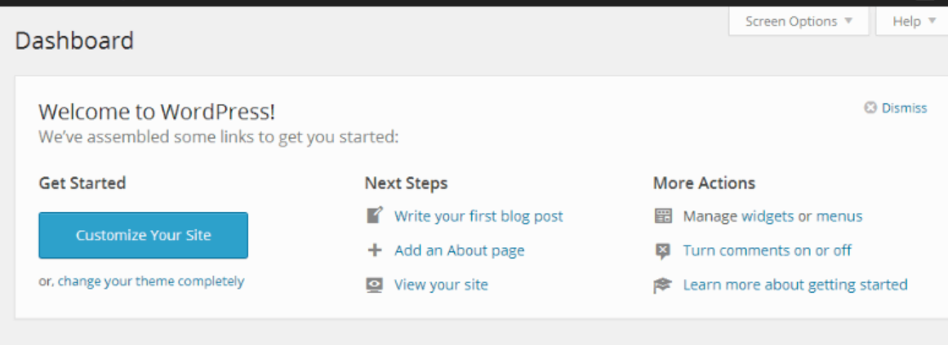
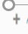
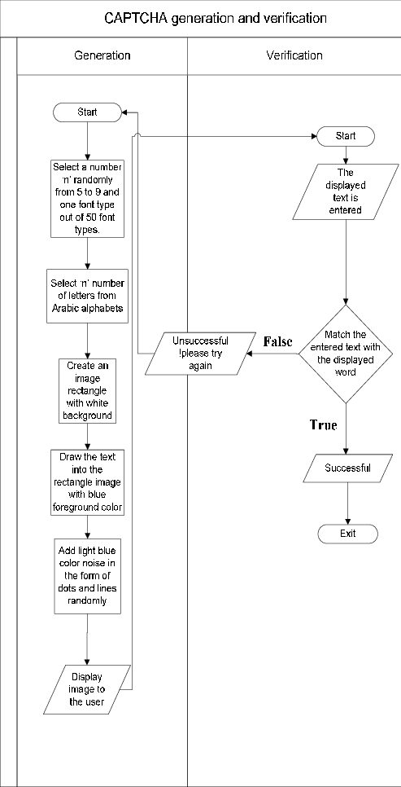

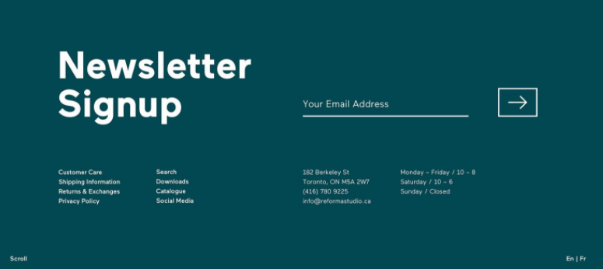
Welcome to RirekiSHOW
Start filtering Candidates
Redirect
New updates
Job Profiles
Vacancies
Fresh Graduates
Search
Catalogue
Download
Social Media
827-0021
Beppu-shi, Kamegawa,
123 Building
soujda18@apu.ac.jp
Mon-Fri/ 10-6
Sat- 10-8
Sun- closed
En/ Jp

Slide 11
Functional Block Diagram
.Storing processed informative data.
Storage
MySQL database
Taking input from several candidates
Candidate information
AI implementation
Training data to be fed- reinforcement learning
Generates/ suggests possible candidates for a company and vice-versa
Filters to be fed as data as well
PHP <-> MySQL
Hypothetical user information web service
Info Input
Or tools
Filtering out required data of clients
Internet Mashups
Displaying potential clients
Output
CSS minification services
Using Tableau to visualize user traffic with filters of date etc.
Loginizer to block malicious login attempts.
DDoS attack protection from hackers.
.Collecting information of candidates. .Creating a user less profile and dashboard for client. .Implementing various web services like google translate and adsence.
Security
User traffic minimization
To improve response time and server dependencies
Company selecting potential candidates

Slide 12
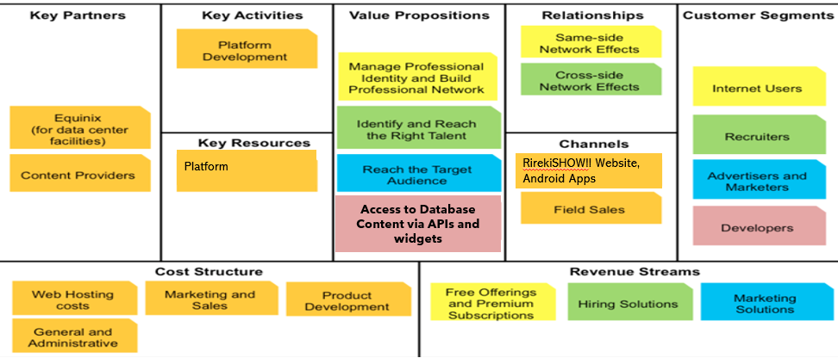
Rough Business Model

Slide 13

Competitive Analysis
Direct competitors
LinkedIn
Recruit (Japan)
Naukri.com (India) etc.
Indirect competitors
1. On-campus recruiting for universities
2. Global fares etc.
How are we different? (a RESTful web service)
To ensure the confidentiality between the client and the server site and the integrity of the communicated data, we use digital handshakes as a protocol in our web security. The digital handshake involves three phrases with one or more messages exchanged between the client side and the server side. There is another form of handshake which is SSL/TSL which is a negotiation between two parties in the network such as the browser and the web server which helps in establishing the details between the connection.

Slide 14

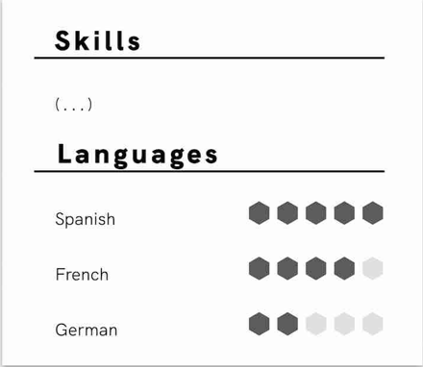
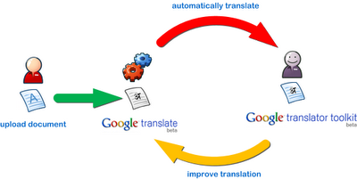

Unique Feature (Different from other companies)
Resume translation with Google translator and crowdsourcing
日本
スキル
言語能力
スペイン語
フランス語
Privacy Policy for the same
Personal information like name, user ID, address, mobile number etc. will not be disclosed to third-party for translation of the resume.
Either rating or translating on demand
ドイツ語
If the translation is still not being accepted, then..
Checking second-hand (crowdsourcing of translation service)
Notes:
Google translate now has a responsive design which can adjust to our screen size accordingly since the last twelve years, there is a rapid growth from translating from English to different languages. This company’s free service instantly translates words, phrases and web pages. It has become an essential tool for communicating across languages. Additionally, there are now labels to each shape translation to help find them easily. Google ads: it is a paid advertising platform that falls under a marketing channel known as pay-per-click.

Slide 15

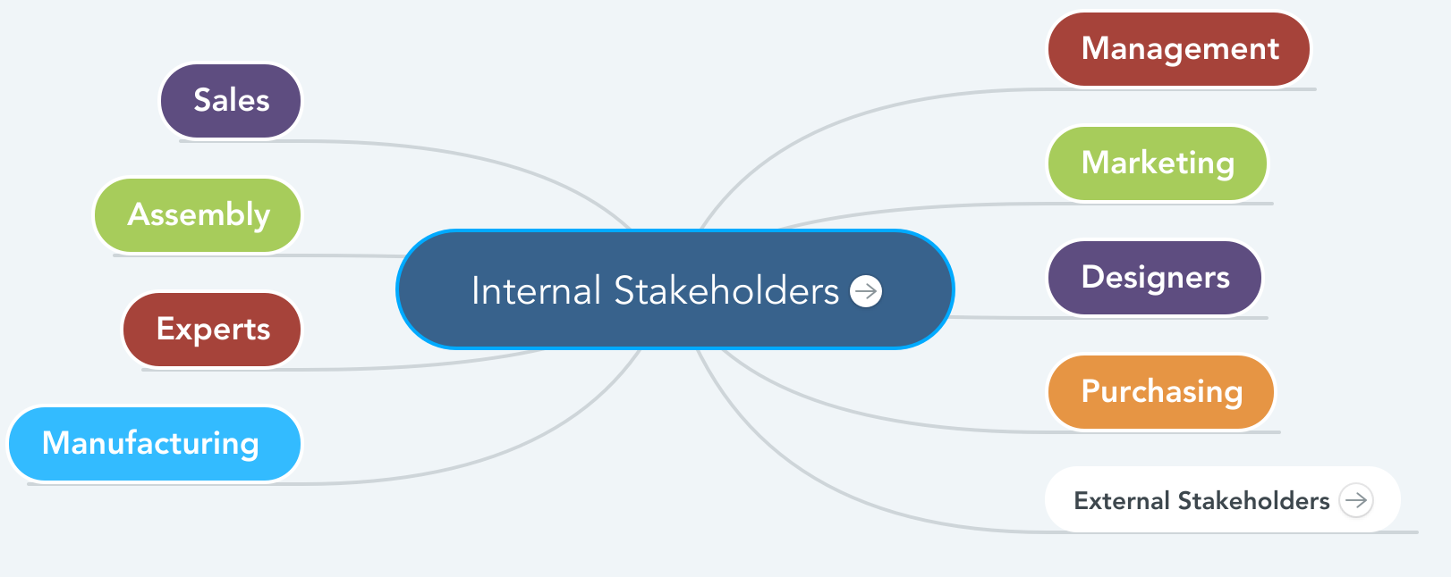
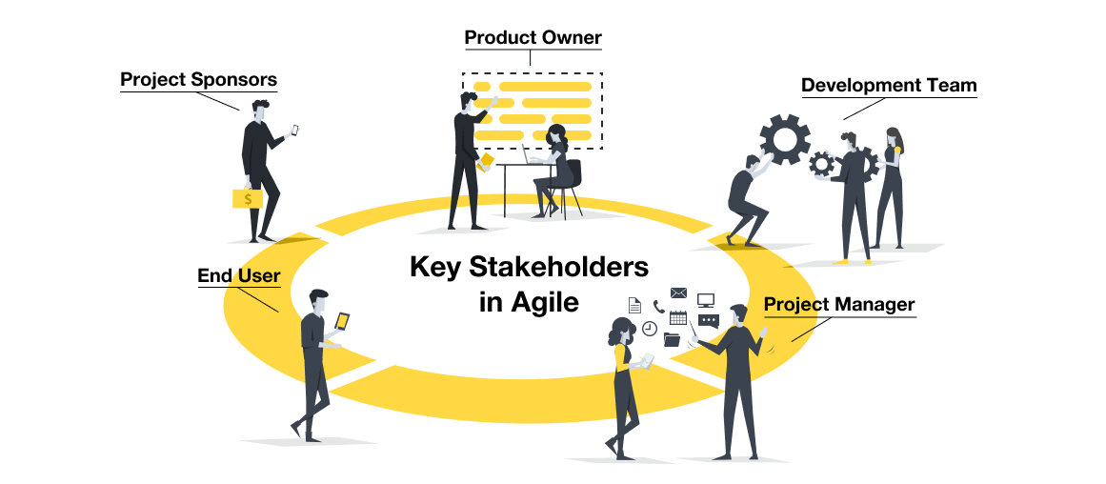
Internal Stakeholders
Web designers, Blogger
Content manager, creator
Data miners, database,
Analysts
Back-end server specialists
Server managers
Sales, HR, marketing
Suppliers: Data supplier, Software providers (Tableau etc.)
The project manager, sponsor, or management team
GOOGLE, Mailchimp etc.

Slide 16

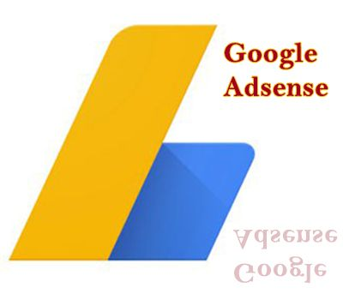
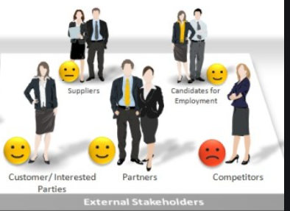
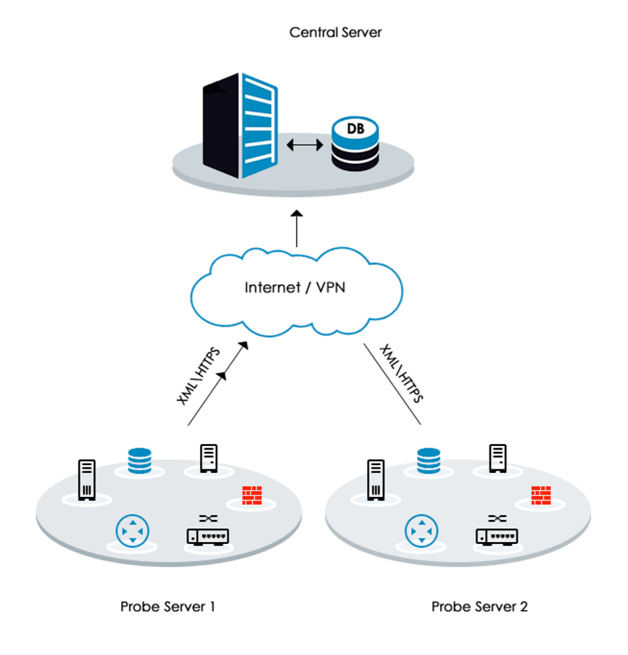

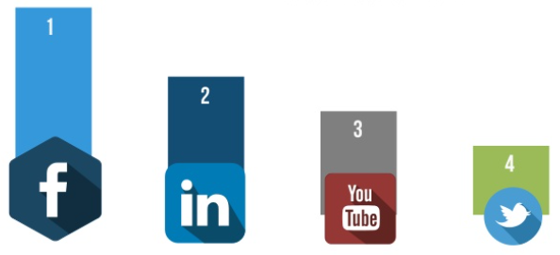




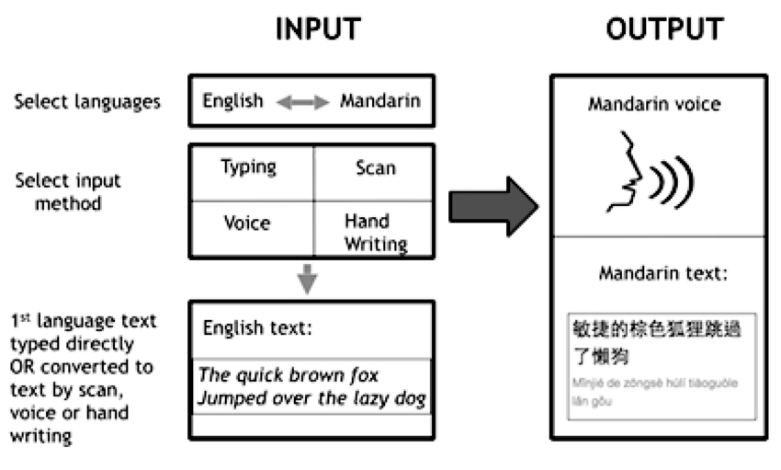



External Stakeholders model
GOOGLE Adsense
Ad posting
R studio & Tableau server (For visualization & ML purposes)
Ad Fees
Portfolio mgt.
Secured using DDoS (Cloudflare)
Sheer competition
Ad posting
Client: Job searchers
Promotion
Internet Cafe
Searches for job
Lending money
Creditor
Translation service
Information and AI powered suggestions
uses
Companies (HR) searching for potential employees
Searches for potential candidates
Mailchimp marketing
Gateways for transactions
Android/ Ios

Slide 17
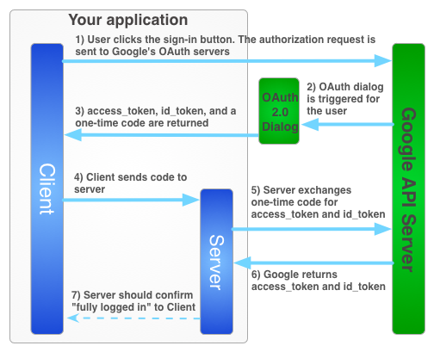
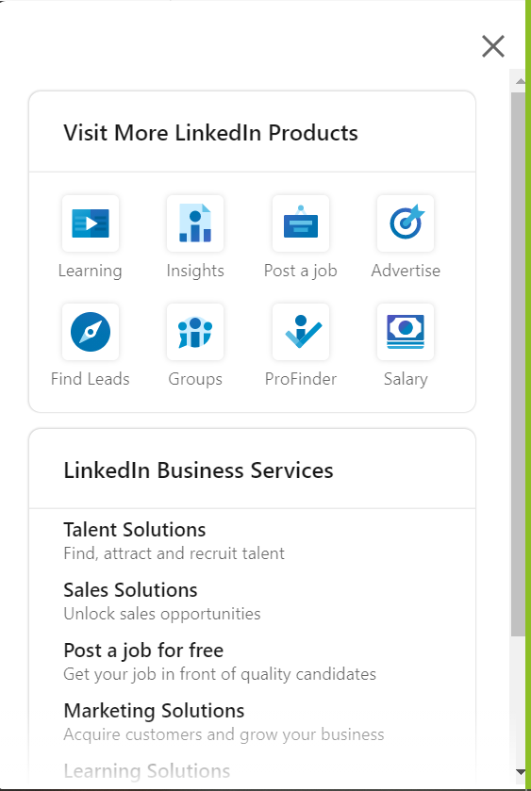
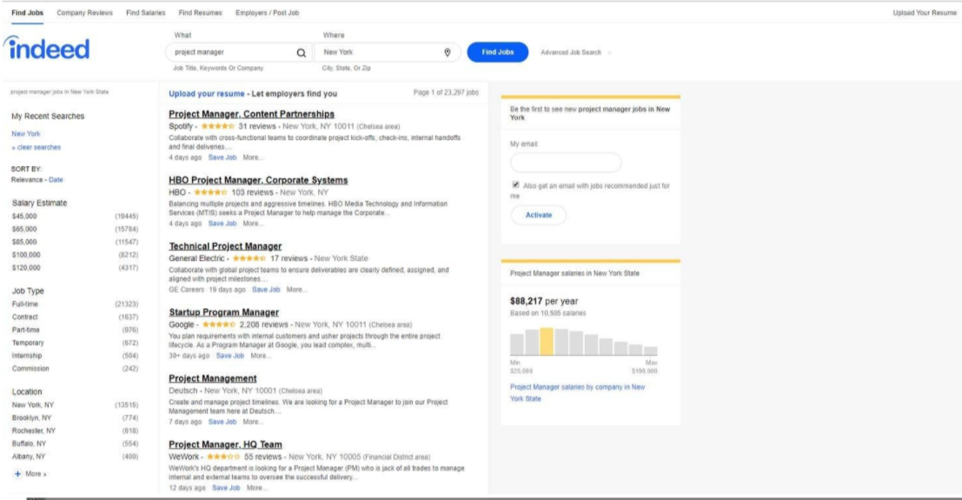

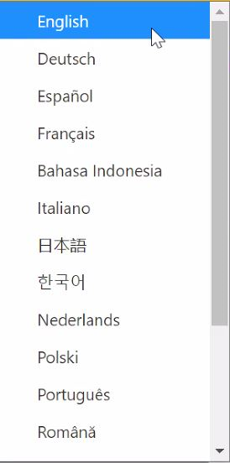
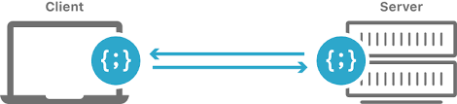
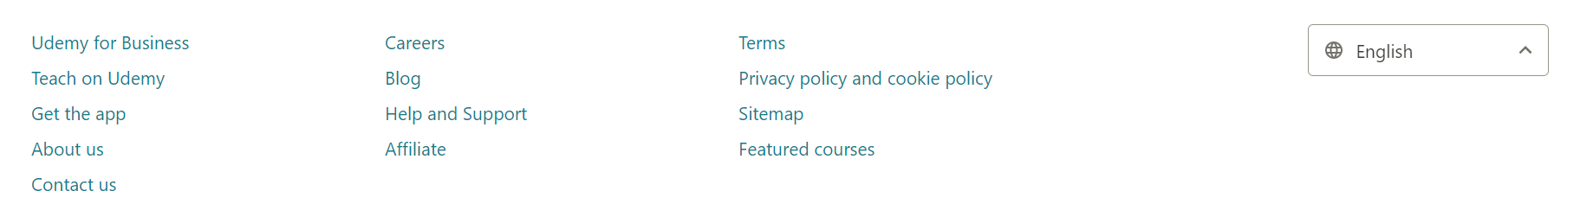
Mock GUI diagram
Resume
Company information

Slide 18
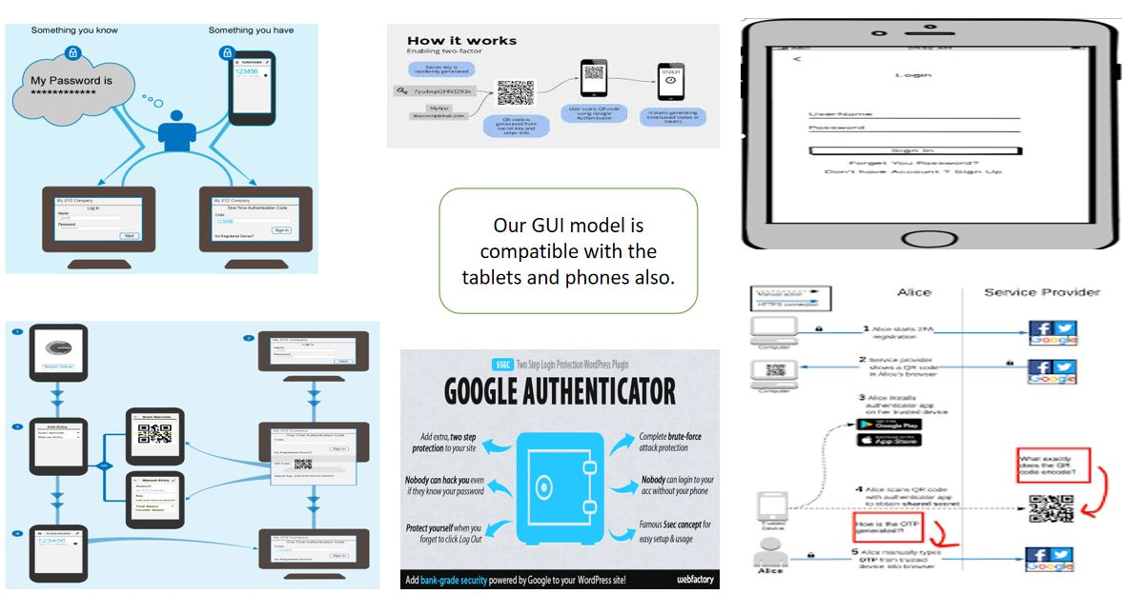
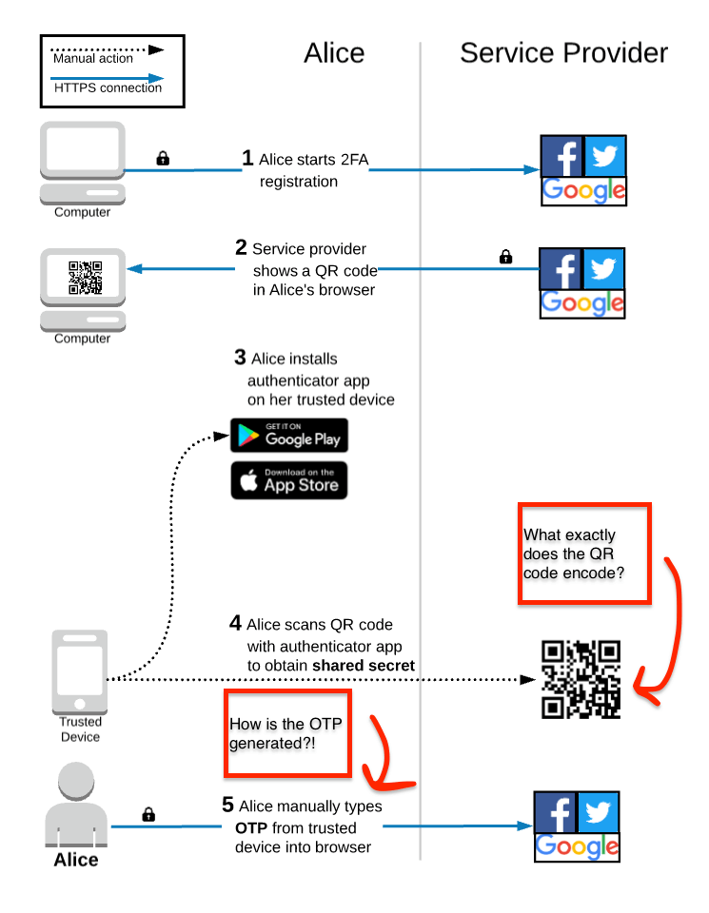
Mock GUI diagram (cont. )

Slide 19
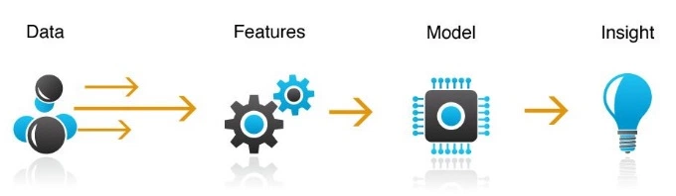
Development Notes
Tools to be used (Inputs):
Search Engine Optimization
Using webpage title as per search engine
Title optimization policy (character limit 60 to 70)
Search engine optimized title
Using meta keyword and meta description
Using focus keyword in webpage title and meta description
Using at least 5 keywords including focus keyword in meta keyword section
Adding relevant image having focus keyword in alternate image text (at least 3 images)
Adding video relevant to the webpage content
Using proper headings (H1,H2,H3…etc.)
Using small paragraphs while writing content
Using interlinking internal webpages through hyperlinking text
Using external website links
Creating backlinks in trusted web source like blogs (Quora, medium, Reddit), social networking sites like Fb business page, Wikipedia etc.
Using google my business to register my business
LinkedIn business profile, using other local listings
Using various search engine web master tools like Bing webmaster, google search console- website to be verified- google puts tag on website
XML blueprint
Advertisement Platform: Google AdWords.
Marketing tools: email marketing tool like mailchimp, web push notifications (push API services)
Using google image capture to verify user not bot, browser cache. Object cache, database cache, cdn like cloud flare, JavaScript/ CSS minification service to reduce server site dependencies & improve response time
Webpage Design Tool: Dreamweaver software (drag and drop method)
Content modelling HTML + CSS (for web design)
JavaScript as client site server scripting language
PHP: dynamic data (encrypted way- more security), browser compiler for the code- server-side scripting language
MySQL as database to store user information
Tableau and Rstudio integration for visualization, project display, interactive graphs.
ML software like Weka etc.
Developer APIs – Facebook, Google etc.
CDN services like Cloudflare for DDoS protection
Tools for newsletter- RSS feets burner to automate newsletter to subscribers
Google Translator
Revenue Generation: Google Adsense, gateway to collect payment from user/ client Eg. Paypal etc.
Notes:
Development Notes: Tools
Search Engine optimization used in the same way as Grammarly (Google Ad Marketing)
Keywords to be used: Jobs in Japan, Resume correction, etc.

Slide 20
Reference slide
https://www.tableau.com/
https://www.google.com/search?q=css+grid&oq=css+grid+&aqs=chrome..69i57j0i433i457j0l6.3412j0j7&sourceid=chrome&ie=UTF-8
https://www.google.com/search?q=carousel&oq=carousel+&aqs=chrome..69i57j0i457j0i433j0j0i20i263j0l2j0i20i263.3107j0j9&sourceid=chrome&ie=UTF-8
https://www.google.com/search?q=media+queries&oq=media+queries&aqs=chrome.0.0i433i457j0i20i263j0l6.4199j0j9&sourceid=chrome&ie=UTF-8
https://www.w3schools.com/html/html_responsive.asp
https://www.javatpoint.com/what-is-database
https://developers.google.com/identity/sign-in/web/server-side-flow
https://www.npgroup.net/blog/how-to-identify-stakeholders-for-your-website-project/
https://smallbusiness.chron.com/linkedin-work-11688.html

